Slide 1


King County Housing Price analysis
COPPER CONSULTING
Alex Dohn
Alex Marhshall
Scott Schumann
COPPER
CONSULTING

Slide 2
Business Problem
Provide modeling by using single family house features for King County
Predict sales price using Linear Regression Modeling
Notes:
Alex M
Alex D

Slide 3

Key Takeaways
Bigger is better!
… but more isn’t necessarily better!
Location! Location! Location!
Grades count!
Notes:
AlexM/ Alex D
Bigger is better!
The larger a property’s square footage, the more a house will sell for
… but More isn’t necessarily
More bedrooms will bring down the price of a house
Location! Location! Location!
A house located close to points of interest (schools, hospitals, etc) will sell for more
A house with a good view will sell for more
Sqftg_living15 – the bigger the houses around you, the price goes up
Grades count!
Grade 9,10,11 – Better, Very Good. Excellent => increase in price if house in this cat
Condition – Good, Very Good => Increase in price if house in this cat,

Slide 4
Data Characteristics
> 21,500 sales records from Kings County for 2014 & 2015
20 separate property features recorded for each sale
Additional features engineered by Copper Consulting
Additional location data from King County GIS Open Data
Police stations
Medical centers
Schools
Farmers Markets
Notes:
Alex M/Alex D

Slide 5
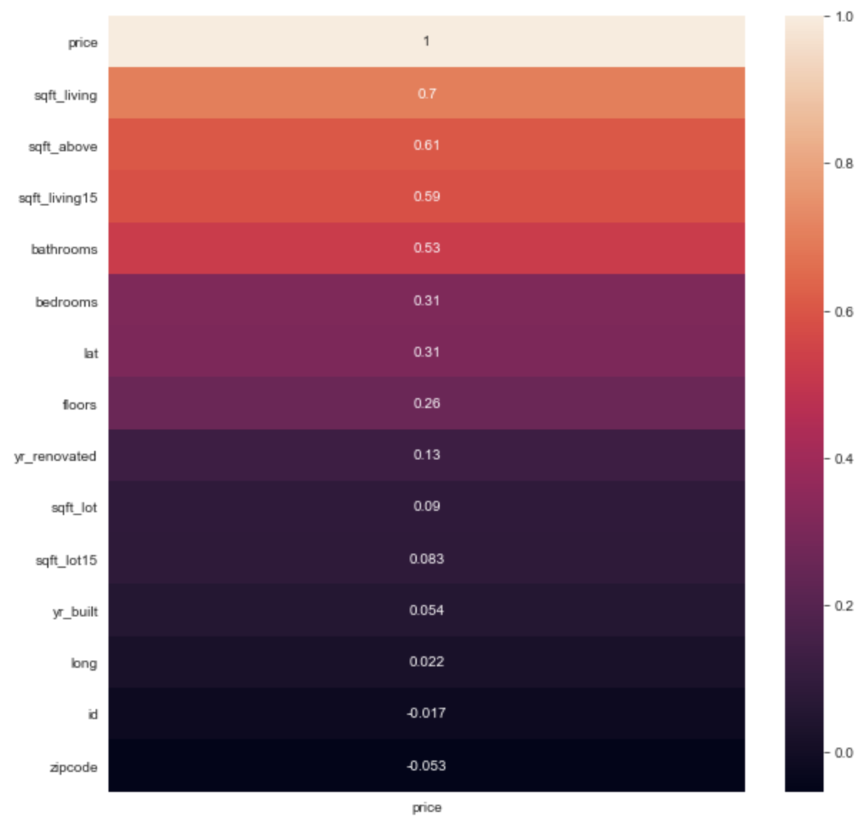
EDA
Examined correlation between price and other features
Notes:
Scott S

Slide 6
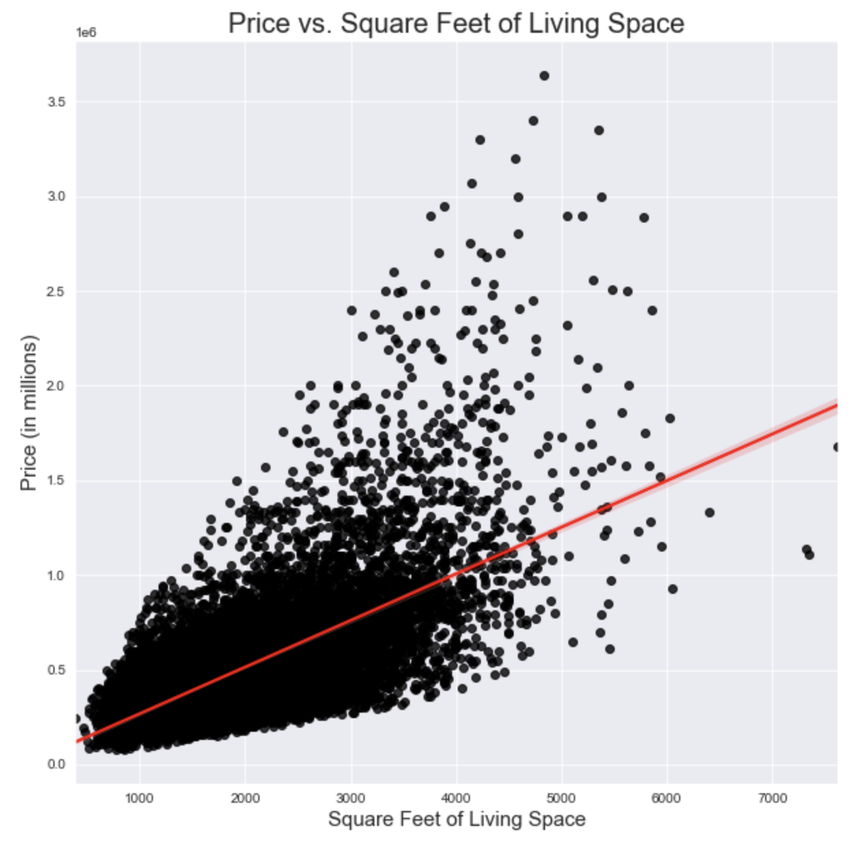
Data Analysis – Square Footage
As housing square footage increases so does price
Notes:
Scott S

Slide 7
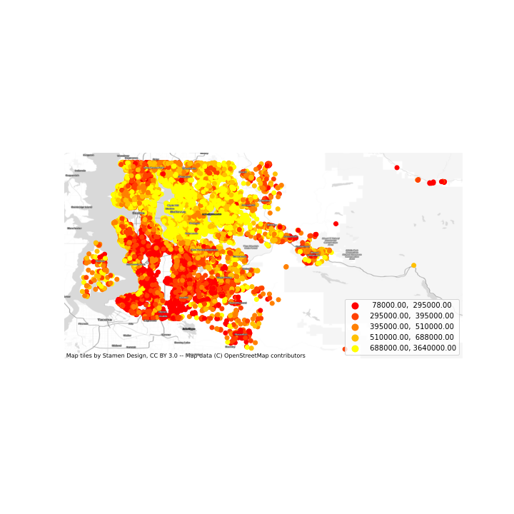
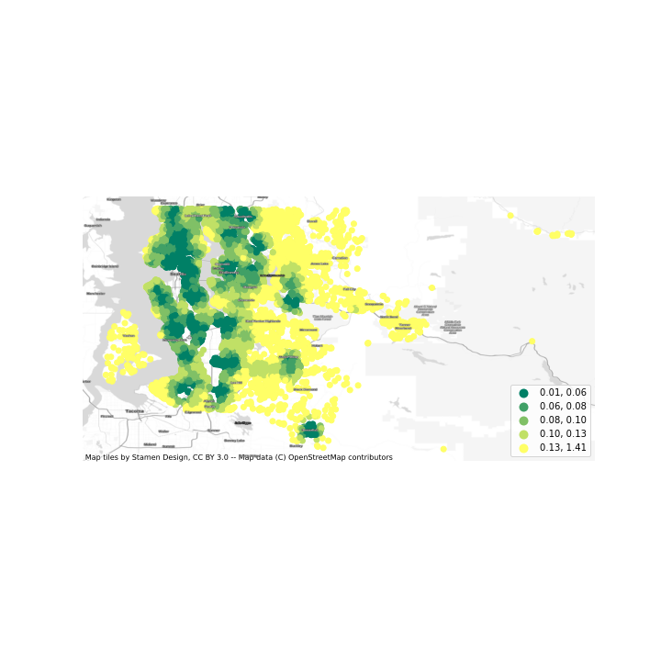
Data Analysis – Geodata Features
GRAPHIC TO COME
Total Distance in Degrees from Points of Interest per House
Price in Dollars per House
Notes:
Alex M
Engineering the feature, confirming viability

Slide 8
Data Analysis – Feature Engineering
View Data – Moved from unclear value analysis to simple Yes/No values
Grade & Condition – Consolidated into above and below Average Grades and Conditions
Bedrooms – remove outliers (>5 bedrooms)
Notes:
Scott S
Engineering the feature, confirming viability

Slide 9
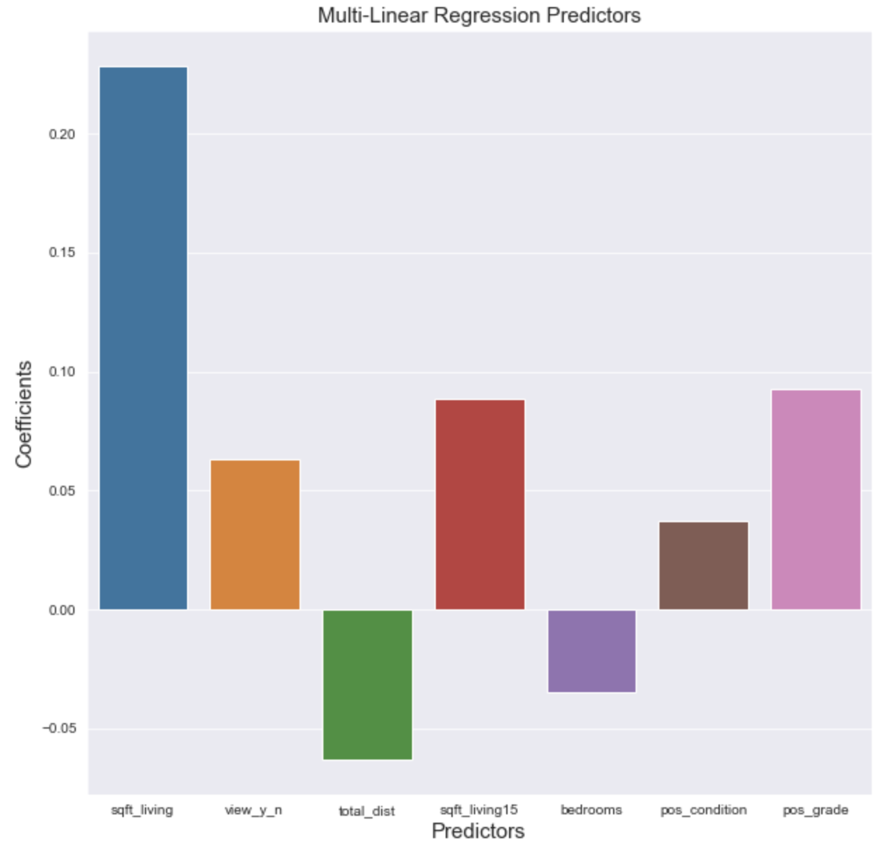
Results
Notes:
Scott S

Slide 10
Results
Model explains 52% of the variance in sales prices for homes in King County
Square footage : 23% increase in sales price
Square footage of 15 closest neighbors: 9% increase in sales price
High Grade: 9% increase in sales price
Notes:
Scott S

Slide 11

Next Steps & Improvements
Add more location data
Feature engineering with Condition and Grade
Identify relationships with Year Built and Year Renovated
Explore room number and type
Leverage zip code data
Examine properties with multiple sales records
Price changes
Feature changes
Notes:
Alex M

Slide 12
Thank you!
COPPER
CONSULTING

